Slide 1

Programming with Python
Chapter 6

Slide 2
Functions as Abstraction Mechanisms
An abstraction hides detail
Allows a person to view many things as just one thing
We use abstractions to refer to the most common tasks in everyday life
For example, the expression “doing my laundry”
Effective designers must invent useful abstractions to control complexity

Slide 3
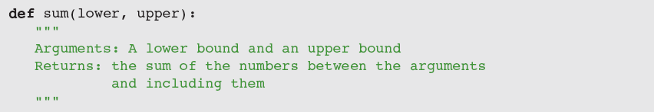
Functions Eliminate Redundancy
Functions serve as abstraction mechanisms by eliminating redundant, or repetitious, code

Slide 4
Functions Hide Complexity
Functions serve as abstraction mechanisms is by hiding complicated details
For example, consider the previous sum function
The idea of summing a range of numbers is simple; the code for computing a summation is not
A function call expresses the idea of a process to the programmer
Without forcing him/her to wade through the complex code that realizes that idea

Slide 5
Functions Support General Methods with Systematic Variations
An algorithm is a general method for solving a class of problems
The individual problems that make up a class of problems are known as problem instances
What are the problem instances of our summation algorithm?
Name other problem instances that can be solved by an algorithm.
Algorithms should be general enough to provide a solution to many problem instances
A function should provide a general method with systematic variations

Slide 6
Functions Support the Division of Labor
In a well-organized system, each part does its own job in collaborating to achieve a common goal
In a computer program, functions can enforce a division of labor
Each function should perform a single coherent task
Example: Computing a summation
Each of the tasks required by a system can be assigned to a function
Including the tasks of managing or coordinating the use of other functions

Slide 7
Problem Solving with Top-Down Design
Top-down design starts with a global view of the entire problem and breaks the problem into smaller, more manageable subproblems
Process known as problem decomposition
As each subproblem is isolated, its solution is assigned to a function
As functions are developed to solve subproblems, solution to overall problem is gradually filled out
Process is also called stepwise refinement

Slide 8
The Design of the Text-Analysis Program

Slide 9
The Design of the Sentence-Generator Program

Slide 10
The Design of the Doctor Program

Slide 11
Design with Recursive Functions
In top-down design, you decompose a complex problem into a set of simpler problems and solve these with different functions
In some cases, you can decompose a complex problem into smaller problems of the same form
Subproblems can be solved using the same function
This design strategy is called recursive design
Resulting functions are called recursive functions

Slide 12
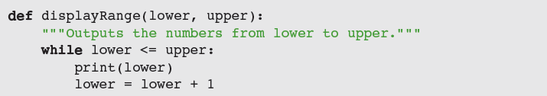
Defining a Recursive Function
A recursive function is a function that calls itself
To prevent function from repeating itself indefinitely, it must contain at least one selection statement
Statement examines base case to determine whether to stop or to continue with another recursive step
To convert displayRange to a recursive function:
You can replace loop with a selection statement and assignment statement with a recursive call

Slide 13
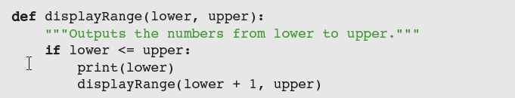
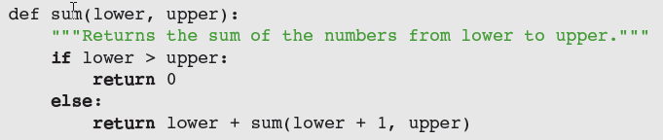
Defining a Recursive Function
Making displayRange recursive (continued):
Most recursive functions expect at least one argument
Another example: Recursive version of sum

Slide 14
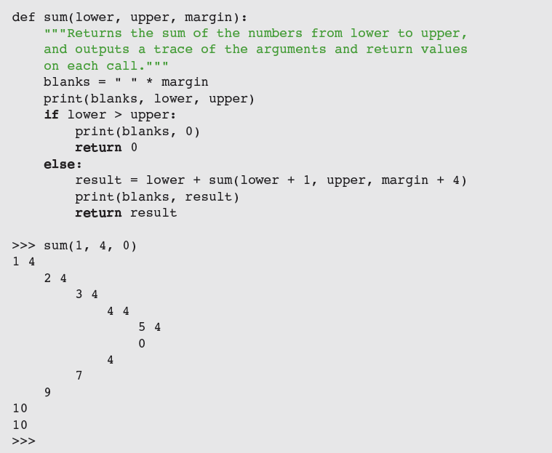
Tracing a Recursive Function

Slide 15
Using Recursive Definitions to Construct Recursive Functions
Recursive functions are frequently used to design algorithms that have a recursive definition
A recursive definition consists of equations that state what a value is for one or more base cases and one or more recursive cases
Example: Fibonacci sequence
1 1 2 3 5 8 13 . . .

Slide 16
Recursion in Sentence Structure
Recursive solutions can often flow from the structure of a problem
Example: Structure of sentences in a language
A noun phrase can be modified by a prepositional phrase, which also contains another noun phrase
← Indirect recursion

Slide 17
Infinite Recursion
Infinite recursion arises when programmer fails to specify base case or to reduce size of problem in a way that terminates the recursive process
In fact, the Python virtual machine eventually runs out of memory resources to manage the process

Slide 18
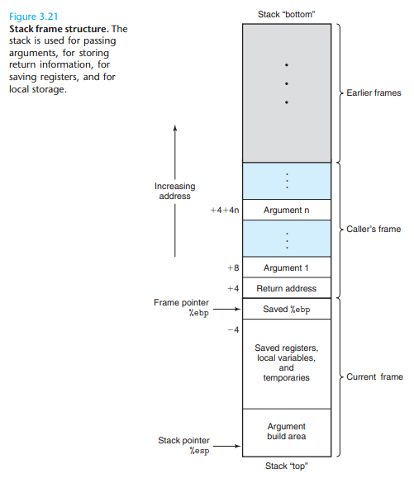
The Costs and Benefits of Recursion
Python Virtual Machine (PVM) reserves an area of memory for the call stack
For each call of a function, the PVM must allocate on the call stack a stack frame, which contains:
Values of the arguments
Return address for the particular function call
Space for the function call’s return value
When a call returns, return address is used to locate the next instruction, and stack frame is deallocated
Amount of memory needed for a loop does not grow with the size of the problem’s data set
http://jasonleaster.github.io/blog/2016/02/21/architecture-of-python-virtual-machine/

Slide 19
The Costs and Benefits of Recursion

Slide 20
Case Study: Gathering Information from a File System
Request: Write a program that allows the user to obtain information about the file system
Analysis:
File systems are tree-like structures
At the top of the tree is the root directory
Under the root are files and subdirectories
Each directory in the system except the root lies within another directory called its parent
Example of a path (UNIX-based file system):
/Users/KenLaptop/Book/Chapter6/Chapter6.doc

Slide 21
Case Study: Gathering Information from a File System

Slide 22
Case Study: Gathering Information from a File System (continued)
When user enters a number, program runs command; then, displays CWD and menu again
An unrecognized command produces an error message

Slide 23
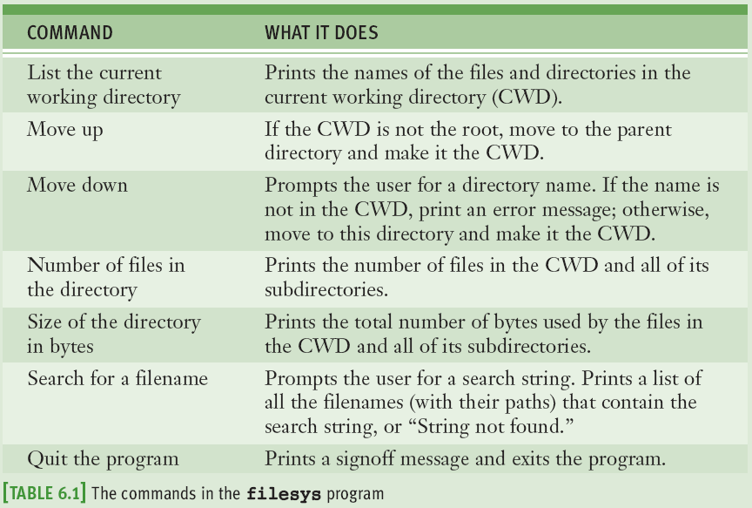
Case Study: Gathering Information from a File System (continued)

Slide 24
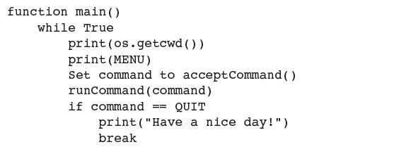
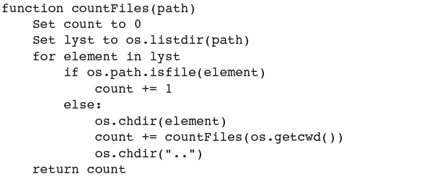
Case Study: Gathering Information from a File System – Design

Slide 25
Case Study: Gathering Information from a File System (continued)
…

Slide 26
Managing a Program’s Namespace
A program’s namespace is the set of its variables and their values
You can control it with good design principles

Slide 27
Module Variables, Parameters, and Temporary Variables
Module variables and temporary variables receive their values as soon as they are introduced
Parameters behave like a variable and are introduced in a function or method header
Do not receive a value until the function is called
doctor.py file (module name is doctor):
A module variable A parameter name
A temporary variable
A method name

Slide 28
Scope
Scope: Area in which a name refers to a given value
Temporary variables are restricted to the body of the functions in which they are introduced
Parameters are invisible outside function definition
The scope of module variables includes entire module below point where they are introduced
A function can reference a module variable, but can’t under normal circumstances assign a new value to it

Slide 29
Lifetime
Variable’s lifetime: Period of time when variable has memory storage associated with it
When a variable comes into existence, storage is allocated for it; when it goes out of existence, storage is reclaimed by the PVM
Module variables come into existence when introduced and generally exist for lifetime of program that introduces or imports them
Parameters and temporary variables come into existence when bound to values during call, but go out of existence when call terminates

Slide 30
Default (Keyword) Arguments
Arguments provide the function’s caller with the means of transmitting information to the function
Programmer can specify optional arguments with default values in any function definition:
Following the required arguments are one or more default or keyword arguments
When function is called with these arguments, default values are overridden by caller’s values

Slide 31
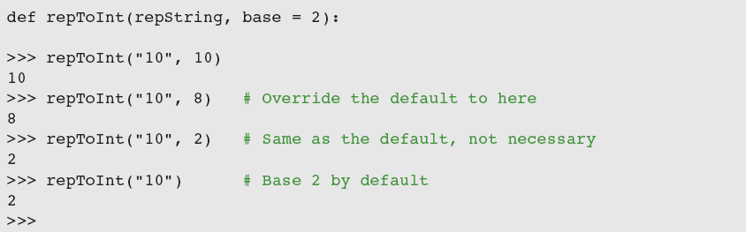
Default (Keyword) Arguments

Slide 32
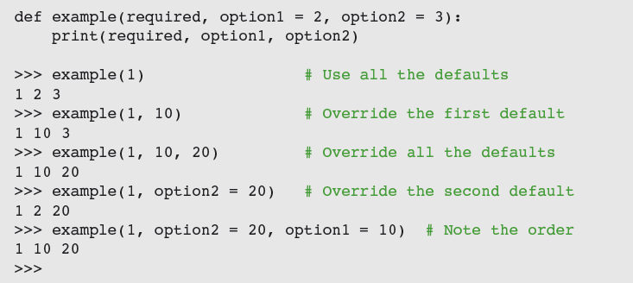
Default (Keyword) Arguments
The default arguments that follow can be supplied in two ways:
By position
By keyword

Slide 33
Functions as First-Class Data Objects
Functions can be assigned to variables, passed as arguments, returned as the values of other functions, and stored in data structures

Slide 34
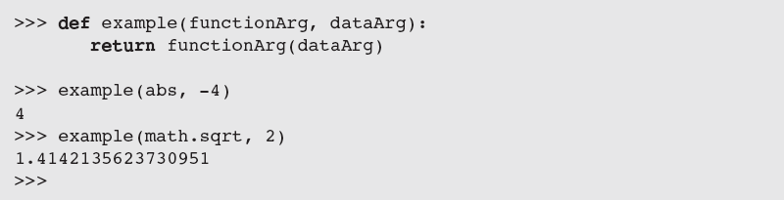
Functions as First-Class Data Objects
Passing a function as an argument is no different from passing any other datum:

Slide 35
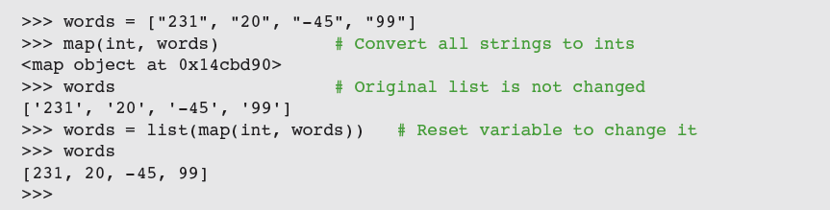
Mapping
Mapping applies a function to each value in a sequence and returns a new sequence of the results

Slide 36
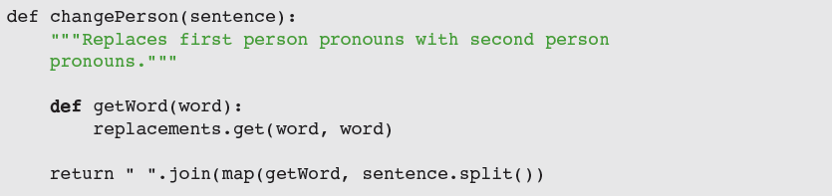
Mapping

Slide 37
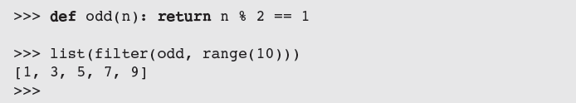
Filtering
When filtering, a function called a predicate is applied to each value in a list
If predicate returns True, value is added to a new list; otherwise, value is dropped from consideration

Slide 38
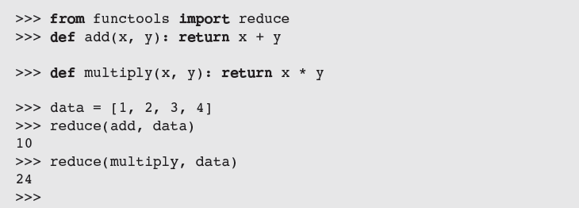
Reducing
When reducing, we take a list of values and repeatedly apply a function to accumulate a single data value

Slide 39
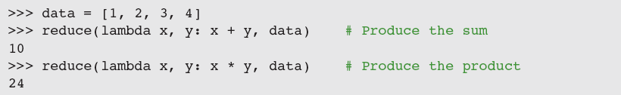
Using lambda to Create Anonymous Functions
A lambda is an anonymous function
When the lambda is applied to its arguments, its expression is evaluated and its value is returned

Slide 40
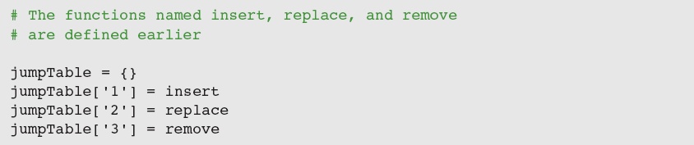
Creating Jump Tables
A jump table is a dictionary of functions keyed by command names

Slide 41
Summary
A function serves as abstraction mechanism and eliminates redundant patterns of code
Top-down design is strategy that decomposes complex problem into simpler subproblems and assigns their solutions to functions
A structure chart is diagram of relationships among cooperating functions
Recursive design is special case of top-down design, in which complex problem is decomposed into smaller problems of the same form

Slide 42
Summary
A recursive function is a function that calls itself
Parts: Base case and recursive step
Can be computationally expensive
Programmers must avoid infinite recursion
Program namespace structured in terms of module variables, parameters, and temporary variables
Scope can be used to control the visibility of names in a namespace
The lifetime of a variable is duration of program execution during which it uses memory storage

Slide 43
Summary
Functions are first-class data objects
Higher-order functions can expect other functions as arguments and/or return functions as values
A mapping function expects a function and a list of values as arguments
A predicate is a Boolean function
A filtering function expects a predicate and a list of values as arguments
A reducing function expects a function and a list of values as arguments

